Slide 1
Privacy en Gegevensbescherming

Slide 2
Overzicht van dit college
(1) Privacy en gegevensbescherming
(2) Pauze
(3) Smart meter

Slide 3
Grondwet
Artikel 10 1Ieder heeft, behoudens bij of krachtens de wet te stellen beperkingen, recht op eerbiediging van zijn persoonlijke levenssfeer. 2De wet stelt regels ter bescherming van de persoonlijke levenssfeer in verband met het vastleggen en verstrekken van persoonsgegevens. 3De wet stelt regels inzake de aanspraken van personen op kennisneming van over hen vastgelegde gegevens en van het gebruik dat daarvan wordt gemaakt, alsmede op verbetering van zodanige gegevens. | Artikel 12 Het binnentreden in een woning zonder toestemming van de bewoner is alleen geoorloofd in de gevallen bij of krachtens de wet bepaald, door hen die daartoe bij of krachtens de wet zijn aangewezen. 2Voor het binnentreden overeenkomstig het eerste lid zijn voorafgaande legitimatie en mededeling van het doel van het binnentreden vereist, behoudens bij de wet gestelde uitzonderingen. 3Aan de bewoner wordt zo spoedig mogelijk een schriftelijk verslag van het binnentreden verstrekt. Indien het binnentreden in het belang van de nationale veiligheid of dat van de strafvordering heeft plaatsgevonden, kan volgens bij de wet te stellen regels de verstrekking van het verslag worden uitgesteld. In de bij de wet te bepalen gevallen kan de verstrekking achterwege worden gelaten, indien het belang van de nationale veiligheid zich tegen verstrekking blijvend verzet.
Artikel 10 Ieder heeft, behoudens bij of krachtens de wet te stellen beperkingen, recht op onaantastbaarheid van zijn lichaam. | Artikel 13 1Het briefgeheim is onschendbaar, behalve, in de gevallen bij de wet bepaald, op last van de rechter. 2Het telefoon- en telegraafgeheim is onschendbaar, behalve, in de gevallen bij de wet bepaald, door of met machtiging van hen die daartoe bij de wet zijn aangewezen.

Slide 4
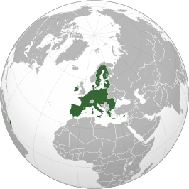
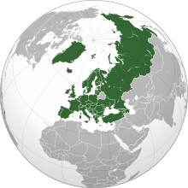
Europese Unie en Raad van Europa

Slide 5
Europees Verdrag voor de Rechten van de Mens
ARTICLE 8
Right to respect for private and family life
1. Everyone has the right to respect for his private and family life, his home and his correspondence.
2. There shall be no interference by a public authority with the exercise of this right except such as is in accordance with the law and is necessary in a democratic society in the interests of national security, public safety or the economic well-being of the country, for the prevention of disorder or crime, for the protection of health or morals, or for the protection of the rights and freedoms of others.

Slide 6
Handvest van de Grondrechten van de EU
Artikel 7 De eerbiediging van het privé-leven en van het familie- en gezinsleven | Artikel 8 De bescherming van persoonsgegevens
Eenieder heeft recht op eerbiediging van zijn privé-leven, zijn familie- en gezinsleven, zijn woning en zijn communicatie. | 1. Eenieder heeft recht op bescherming van zijn persoonsgegevens. 2. Deze gegevens moeten eerlijk worden verwerkt, voor bepaalde doeleinden en met toestemming van de betrokkene of op basis van een andere gerechtvaardigde grondslag waarin de wet voorziet. Eenieder heeft recht van inzage in de over hem verzamelde gegevens en op rectificatie daarvan. 3. Een onafhankelijke autoriteit ziet erop toe dat deze regels worden nageleefd.

Slide 7
Handvest van de Grondrechten van de EU
Artikel 15 Vrijheid van beroep en recht om te werken
1. Eenieder heeft het recht te werken en een vrijelijk gekozen of aanvaard beroep uit te oefenen.
2. Iedere burger van de Unie is vrij om werk te zoeken, te werken, zich te vestigen of diensten te verrichten in iedere lidstaat.
3. Onderdanen van derde landen die op het grondgebied van de lidstaten mogen werken, hebben recht op arbeidsvoorwaarden die gelijkwaardig zijn aan die welke de burgers van de Unie genieten.
Artikel 16 Vrijheid van ondernemerschap
De vrijheid van ondernemerschap wordt erkend overeenkomstig het Gemeenschapsrecht en de nationale wetgevingen en praktijken.
Artikel 17 Recht op eigendom
1. Eenieder heeft het recht de goederen die hij rechtmatig heeft verkregen in eigendom te bezitten, te gebruiken, erover te beschikken en te vermaken. Aan niemand mag zijn eigendom worden ontnomen, behalve in het algemeen belang in de gevallen en onder de voorwaarden waarin de wet voorziet en mits zijn verlies tijdig op billijke wijze wordt vergoed. Het gebruik van de goederen kan worden geregeld bij de wet voorzover het algemeen belang dit vereist.
2. Intellectuele eigendom is beschermd.

Slide 8
De Algemene Verordening Gegevensbescherming: toepassing
(1) Persoonsgegevens
(2) Verwerken
(3) Verantwoordelijke, verwerker
(4) EU recht
(5) Uitzondering

Slide 9
(1) Persoonsgegevens
Article 4 ‘personal data’ means any information relating to an identified or identifiable natural person (‘data subject’); an identifiable natural person is one who can be identified, directly or indirectly, in particular by reference to an identifier such as a name, an identification number, location data, an online identifier or to one or more factors specific to the physical, physiological, genetic, mental, economic, cultural or social identity of that natural person;

Slide 10
(1) Persoonsgegeven
Dat kan zijn een direct persoonsgegeven of een indirect persoonsgegeven. Een direct persoonsgegeven is bijvoorbeeld iemands naam. Een indirect gegeven is een specifiek detail aan iemand, bijvoorbeeld: ‘het zeilmeisje wilde de hele wereld over, maar de rechter verbood het haar’. In dit verband is ‘het zeilmeisje’ voldoende om iemand, namelijk Laura Dekker, te identificeren.
Het gaat zowel om privé als publieke gegevens. Ook de term ‘die persoon daar, naast de lantaarnpaal, met de oranje stropdas’ is een persoonsgegeven. Of het gegeven dus publiekelijk toegankelijk en openbaar is of niet, of het gegeven een feit van algemene bekendheid is of niet, een gegeven zal als ‘persoonsgegeven’ hebben te gelden als er iemand mee geïdentificeerd kan worden. Daarvoor is het niet nodig dat je ook de naam van de persoon met de oranje stropdas weet.
Het gaat om gevoelige informatie (Meneer De Wit heeft prostaatkanker), maar een persoonsgegeven kan ook hele gewone informatie bevatten - zoals het feit dat iemand een oranje stropdas draagt. De gevoeligheid van een gegeven doet er in dit opzicht dus niet toe – wel is het zo dat bij de verwerking van gevoelige gegevens aan meer voorwaarden moet worden voldaan.
Het gaat om identificerende gegevens, informatie waarmee je iemand direct kan identificeren, maar ook om identificeerbare gegevens. Die laatste zijn bijvoorbeeld gegevens die op dit moment nog niemand identificeren, maar dat op termijn wel kunnen doen. Stel, je hebt twee databases die op zichzelf niemand uniek kunnen identificeren, maar als ze worden samengevoegd wel, dan kan het zijn dat ook de afzonderlijke databases moeten worden gezien als bevattende persoonsgegevens, nog voordat ze daadwerkelijk worden gekoppeld.
Niet alleen de ‘identificeerbaarheid’ is van belang, ook de ‘individualiseerbaarheid’ van mensen is essentieel. Stel, je hebt een profiel van iemand gemaakt, bijvoorbeeld door informatie die je online verzamelt via cookies, maar je weet niet precies wie het is. Toch kan je die persoon wel individueel tracken en daarop bepaalde handelingen ondernemen, zoals het aanbieden van gepersonaliseerde advertenties of content. Dan vallen de gegevens in principe ook onder het begrip ‘persoonsgegeven’.

Slide 11
(2) Verwerken
Article 4 (2) ‘processing’ means any operation or set of operations which is performed on personal data or on sets of personal data, whether or not by automated means, such as collection, recording, organisation, structuring, storage, adaptation or alteration, retrieval, consultation, use, disclosure by transmission, dissemination or otherwise making available, alignment or combination, restriction, erasure or destruction;
Article 2 Material scope
1.This Regulation applies to the processing of personal data wholly or partly by automated means and to the processing other than by automated means of personal data which form part of a filing system or are intended to form part of a filing system.

Slide 12
(3) Verantwoordelijke, ververwerker
(7) ‘controller’ means the natural or legal person, public authority, agency or other body which, alone or jointly with others, determines the purposes and means of the processing of personal data; where the purposes and means of such processing are determined by Union or Member State law, the controller or the specific criteria for its nomination may be provided for by Union or Member State law;
(8) ‘processor’ means a natural or legal person, public authority, agency or other body which processes personal data on behalf of the controller;

Slide 13
(3) Verantwoordelijke, ververwerker
“alone or jointly with others”
the context of joint control the participation of the parties to the joint determination may take different forms and does not need to be equally shared. Indeed, in case of plurality of actors, they may have a very close relationship (sharing, for example, all purposes and means of a processing) or a more loose relationship (for example, sharing only purposes or means, or a part thereof). Therefore, a broad variety of typologies for joint control should be considered and their legal consequences assessed, allowing some flexibility in order to cater for the increasing complexity of current data processing reality.

Slide 14
(3) Verantwoordelijke, ververwerker
Therefore, two basic conditions for qualifying as processor are on the one hand being a separate legal entity with respect to the controller and on the other hand processing personal data on his behalf. This processing activity may be limited to a very specific task or context or may be more general and extended.
Plurality of processors: It increasingly happens that processing of personal data is outsourced by a controller to several data processors. These processors may have a direct relationship with the data controller, or be sub-contractors to which the processors have delegated part of the processing activities entrusted to them. These complex (multi-level or diffused) structures of processing personal data are increasing with new technologies and some national laws explicitly refer to them. Nothing in the Directive prevents that on account of organizational requirements, several entities may be designated as data processors or (sub-)processors also by subdividing the relevant tasks. However, all of them are to abide by the instructions given by the data controller in carrying out the processing.

Slide 15
(4) EU recht
Article 3 Territorial scope
1.This Regulation applies to the processing of personal data in the context of the activities of an establishment of a controller or a processor in the Union, regardless of whether the processing takes place in the Union or not.
2.This Regulation applies to the processing of personal data of data subjects who are in the Union by a controller or processor not established in the Union, where the processing activities are related to:
(a) the offering of goods or services, irrespective of whether a payment of the data subject is required, to such data subjects in the Union; or
(b) the monitoring of their behaviour as far as their behaviour takes place within the Union.
3.This Regulation applies to the processing of personal data by a controller not established in the Union, but in a place where Member State law applies by virtue of public international law.

Slide 16
(5) Uitzonderingen
Article 2
2.This Regulation does not apply to the processing of personal data:
(a) in the course of an activity which falls outside the scope of Union law;
(b) by the Member States when carrying out activities which fall within the scope of Chapter 2 of Title V of the TEU;
(c) by a natural person in the course of a purely personal or household activity;
(d) by competent authorities for the purposes of the prevention, investigation, detection or prosecution of criminal offences or the execution of criminal penalties, including the safeguarding against and the prevention of threats to public security.

Slide 17
Kernprincipes
Article 5 Principles relating to processing of personal data
1.Personal data shall be:
(a) processed lawfully, fairly and in a transparent manner in relation to the data subject (‘lawfulness, fairness and transparency’);
(b) collected for specified, explicit and legitimate purposes and not further processed in a manner that is incompatible with those purposes; further processing for archiving purposes in the public interest, scientific or historical research purposes or statistical purposes shall, in accordance with Article 89(1), not be considered to be incompatible with the initial purposes (‘purpose limitation’);
(c) adequate, relevant and limited to what is necessary in relation to the purposes for which they are processed (‘data minimisation’);
(d) accurate and, where necessary, kept up to date; every reasonable step must be taken to ensure that personal data that are inaccurate, having regard to the purposes for which they are processed, are erased or rectified without delay (‘accuracy’);

Slide 18
Kernprincipes
(e) kept in a form which permits identification of data subjects for no longer than is necessary for the purposes for which the personal data are processed; personal data may be stored for longer periods insofar as the personal data will be processed solely for archiving purposes in the public interest, scientific or historical research purposes or statistical purposes in accordance with Article 89(1) subject to implementation of the appropriate technical and organisational measures required by this Regulation in order to safeguard the rights and freedoms of the data subject (‘storage limitation’);
(f) processed in a manner that ensures appropriate security of the personal data, including protection against unauthorised or unlawful processing and against accidental loss, destruction or damage, using appropriate technical or organisational measures (‘integrity and confidentiality’).
2.The controller shall be responsible for, and be able to demonstrate compliance with, paragraph 1 (‘accountability’).

Slide 19
Verwerkingsgrond
Article 6 Lawfulness of processing
1.Processing shall be lawful only if and to the extent that at least one of the following applies:
(a) the data subject has given consent to the processing of his or her personal data for one or more specific purposes;
(b) processing is necessary for the performance of a contract to which the data subject is party or in order to take steps at the request of the data subject prior to entering into a contract;
(c) processing is necessary for compliance with a legal obligation to which the controller is subject; (d) processing is necessary in order to protect the vital interests of the data subject or of another natural person;
(e) processing is necessary for the performance of a task carried out in the public interest or in the exercise of official authority vested in the controller;
(f) processing is necessary for the purposes of the legitimate interests pursued by the controller or by a third party, except where such interests are overridden by the interests or fundamental rights and freedoms of the data subject which require protection of personal data, in particular where the data subject is a child.

Slide 20
Verwerkingsgrond bijzondere persoonsgegevens
Article 9 Processing of special categories of personal data
1.Processing of personal data revealing racial or ethnic origin, political opinions, religious or philosophical beliefs, or trade union membership, and the processing of genetic data, biometric data for the purpose of uniquely identifying a natural person, data concerning health or data concerning a natural person's sex life or sexual orientation shall be prohibited.
2.Paragraph 1 shall not apply if one of the following applies:
(a) the data subject has given explicit consent to the processing of those personal data for one or more specified purposes, except where Union or Member State law provide that the prohibition referred to in paragraph 1 may not be lifted by the data subject;
(b) processing is necessary for the purposes of carrying out the obligations and exercising specific rights of the controller or of the data subject in the field of employment and social security and social protection law in so far as it is authorised by Union or Member State law or a collective agreement pursuant to Member State law providing for appropriate safeguards for the fundamental rights and the interests of the data subject;
(c) processing is necessary to protect the vital interests of the data subject or of another natural person where the data subject is physically or legally incapable of giving consent;
(d) processing is carried out in the course of its legitimate activities with appropriate safeguards by a foundation, association or any other not-for-profit body with a political, philosophical, religious or trade union aim and on condition that the processing relates solely to the members or to former members of the body or to persons who have regular contact with it in connection with its purposes and that the personal data are not disclosed outside that body without the consent of the data subjects;

Slide 21
Verwerkingsgrond bijzondere persoonsgegevens
(e) processing relates to personal data which are manifestly made public by the data subject;
(f) processing is necessary for the establishment, exercise or defence of legal claims or whenever courts are acting in their judicial capacity;
(g) processing is necessary for reasons of substantial public interest, on the basis of Union or Member State law which shall be proportionate to the aim pursued, respect the essence of the right to data protection and provide for suitable and specific measures to safeguard the fundamental rights and the interests of the data subject;
(h) processing is necessary for the purposes of preventive or occupational medicine, for the assessment of the working capacity of the employee, medical diagnosis, the provision of health or social care or treatment or the management of health or social care systems and services on the basis of Union or Member State law or pursuant to contract with a health professional and subject to the conditions and safeguards referred to in paragraph 3;
(i) processing is necessary for reasons of public interest in the area of public health, such as protecting against serious cross-border threats to health or ensuring high standards of quality and safety of health care and of medicinal products or medical devices, on the basis of Union or Member State law which provides for suitable and specific measures to safeguard the rights and freedoms of the data subject, in particular professional secrecy;
(j) processing is necessary for archiving purposes in the public interest, scientific or historical research purposes or statistical purposes in accordance with Article 89(1) based on Union or Member State law which shall be proportionate to the aim pursued, respect the essence of the right to data protection and provide for suitable and specific measures to safeguard the fundamental rights and the interests of the data subject.

Slide 22
Consent
Article 4(11) ‘consent’ of the data subject means any freely given, specific, informed and unambiguous indication of the data subject's wishes by which he or she, by a statement or by a clear affirmative action, signifies agreement to the processing of personal data relating to him or her;
Article 7 Conditions for consent
1.Where processing is based on consent, the controller shall be able to demonstrate that the data subject has consented to processing of his or her personal data.
2.If the data subject's consent is given in the context of a written declaration which also concerns other matters, the request for consent shall be presented in a manner which is clearly distinguishable from the other matters, in an intelligible and easily accessible form, using clear and plain language. Any part of such a declaration which constitutes an infringement of this Regulation shall not be binding.
3.The data subject shall have the right to withdraw his or her consent at any time. The withdrawal of consent shall not affect the lawfulness of processing based on consent before its withdrawal. Prior to giving consent, the data subject shall be informed thereof. It shall be as easy to withdraw as to give consent.
4.When assessing whether consent is freely given, utmost account shall be taken of whether, inter alia, the performance of a contract, including the provision of a service, is conditional on consent to the processing of personal data that is not necessary for the performance of that contract.

Slide 23
Consent
Artikel 8 Voorwaarden voor de toestemming van kinderen met betrekking tot diensten van de informatiemaatschappij
1.Wanneer artikel 6, lid 1, punt a), van toepassing is in verband met een rechtstreeks aanbod van diensten van de informatiemaatschappij aan een kind, is de verwerking van persoonsgegevens van een kind rechtmatig wanneer het kind ten minste 16 jaar is. Wanneer het kind jonger is dan 16 jaar is zulke verwerking slechts rechtmatig indien en voor zover de toestemming of machtiging tot toestemming in dit verband wordt verleend door de persoon die de ouderlijke verantwoordelijkheid voor het kind draagt. De lidstaten kunnen dienaangaande bij wet voorzien in een lagere leeftijd, op voorwaarde dat die leeftijd niet onder 13 jaar ligt
2.Met inachtneming van de beschikbare technologie doet de verwerkingsverantwoordelijke redelijke inspanningen om in dergelijke gevallen te controleren of de persoon die de ouderlijke verantwoordelijkheid voor het kind draagt, toestemming heeft gegeven of machtiging tot toestemming heeft verleend.
3.Lid 1 laat het algemene overeenkomstenrecht van de lidstaten, zoals de regels inzake de geldigheid, de totstandkoming of de gevolgen van overeenkomsten ten opzichte van kinderen, onverlet.

Slide 24
Plichten
Applies to data controller | Applies to data controller and processor
Data Protection Policy | Documentation
Data Protection by Design and Default | Data Protection Officer
Informing the general public | Organisational security measures
Informing the data subject | Technical security measures
Data Protection Impact Assessment | Data breach notification (where the data processor has to inform the data controller of any data breach)

Slide 25
Rechten
Rights | Obligations
Right to information | The data subject can always rely on her right to information. However, if the data controller had adhered to its obligation to inform the data subject, this mostly would not have been necessary.
Right to access | The GDPR encourages (but does not mandate) data controllers to make personal data permanently accessible for data subjects via digital means, so that they do not have to invoke their right to access.
Right to copy | The GDPR encourages (but does not mandate) data controllers to make personal data permanently accessible for data subjects via digital means, so that they do not have to invoke their right to copy.
Right to data portability | The right to data portability is perhaps the only right that does not directly correlate with an independent obligation by the data controller, though it can be seen simply as a combination of the right to copy and the right to erasure.
Right to rectification and completion | If the data subject successfully invokes her right to rectification, this typically means that the data controller has violated one of the FIPs, namely to process personal data only when they are accurate and kept up to date
Right to erasure (right to be forgotten) | The data subject can only successfully exercise her right to erasure (right to be forgotten) if the data controller has processed her personal data unlawfully or without a legitimate ground, thus violating the basic principles of the GDPR
Right not to be subject to automated decision-making | In principle, the data subject should not have to invoke her right not to be subject to automated decision-making, because this doctrine lays down an obligation for organisations not to subject natural persons to automated decision-making (similar to the right to non-discrimination at its core being a duty not to discriminate).
Right to object | If the data subject’s request to stop processing her personal data is granted by the organisation, this means, except where direct marketing is concerned, that the organisation has wrongfully relied on its legitimate interests overriding those of the data subject or on the public interest for which processing the data subject’s data would be necessary as a legal ground for processing personal data.
Right to restrict | The right to restrict applies only if one of the other data subject’s rights is successfully invoked or when data processing is contrary to the GDPR.
Right to file a complaint | If the data subject exercises her right to file a complaint and her claim is granted, this obviously means that the organisation processing her data did not act in line with the GDPR.

Slide 26
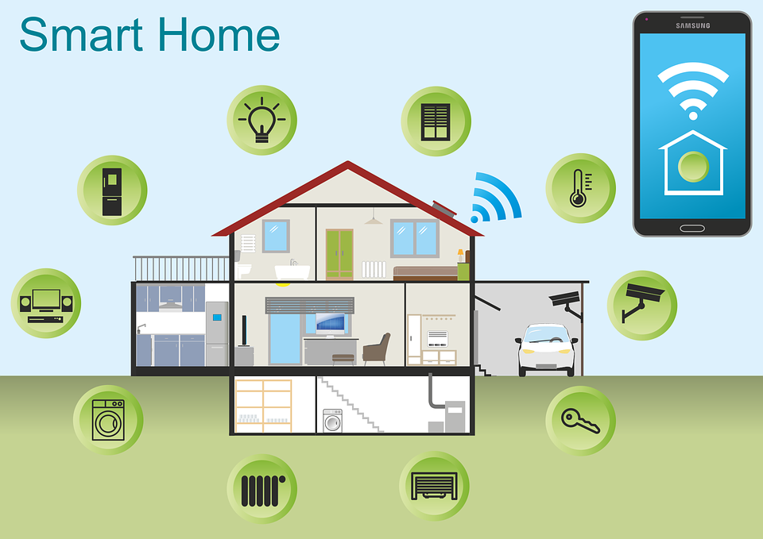
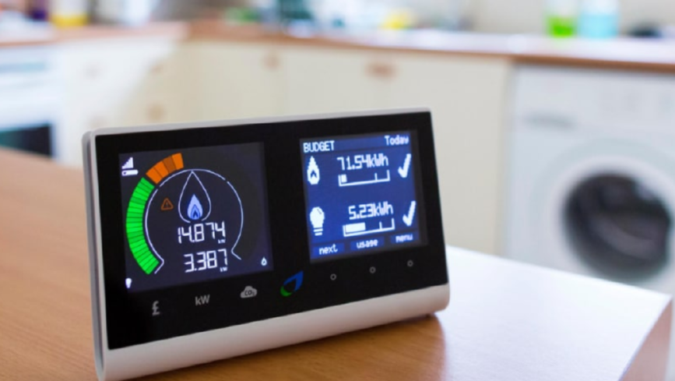
Deel 2: de slimme meter

Slide 30
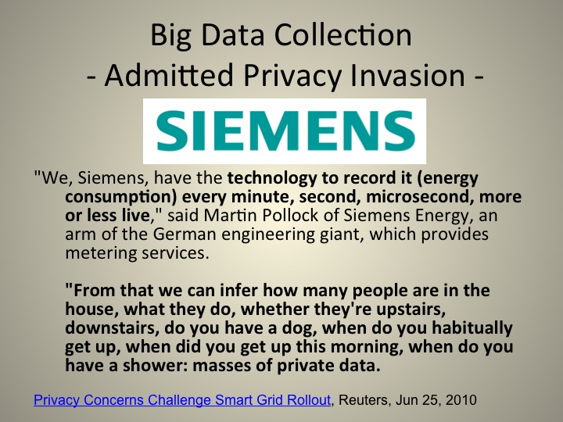

Slide 32
Casus
Anette en Bob wonen samen en hebben twee kinderen, Cor van 12 en Diana van 17.
Op 1 april 2022 is een monteur langsgekomen die vertelde dat hij onderhoudswerkzaamheden moest doen. Naderhand bleek dat hij een slimme meter had geïnstalleerd. ‘Handig, want dan krijgt u goed inzicht in uw energieverbruik en kun u beter besparen, zodat we niet meer zo van Putin afhankelijk zijn’, zegt de monteur.
Op 5 april 2022 schijft de familie een brief naar de in Noorwegen gebaseerde energieleverancier, waarin zij vragen om te stoppen met het verwerken van hun persoonsgegevens. Daarbij doen zij een beroep op de AVG
Op 8 april 2022 schrijft de energieleverancier terug dat er geen persoonsgegevens worden verwerkt en dat, mocht de AVG al van toepassing zijn, er aan alle voorwaarden is voldaan. Bovendien stelt de leverancier dat de gegevens worden gedeeld met Miele, om de familie gerichte aanbiedingen te kunnen doen, die dus als verantwoordelijke moet worden gezien. Ook heeft de familie zelf controle over de gegevens en die gegevens worden verwerkt voor hun eigen doeleinden.
Op 9 april 2022 ziet de familie dat er gegevens over hun energiegebruik op het internet zijn verspreid, waaruit blijkt dat zij bovengemiddeld veel stoken en dat zij vermoedelijk een zonnebank hebben en een Phillips apparaat tegen slaapapneu

Slide 33
AVG Toepasselijk?
1. Gaat het om persoonsgegevens?
2. Worden de gegevens verwerkt?
3. Wie is de verantwoordelijke?
4. Heeft de EU competentie?
5. Is er een uitzondering van toepassing?

Slide 34
Worden de kernbeginselen van de AVG gerespecteerd?
Doel- en doelbinding?
Data minimalisatie?
Verwerkingsgrond?
Bijzondere persoonsgegevens?

Slide 35
Plichten & Rechten
Veilig en vertrouwelijk?
Is de familie afdoende geïnformeerd?
Op welke rechten zou de familie hier een beroep kunnen doen?

